Slide 1
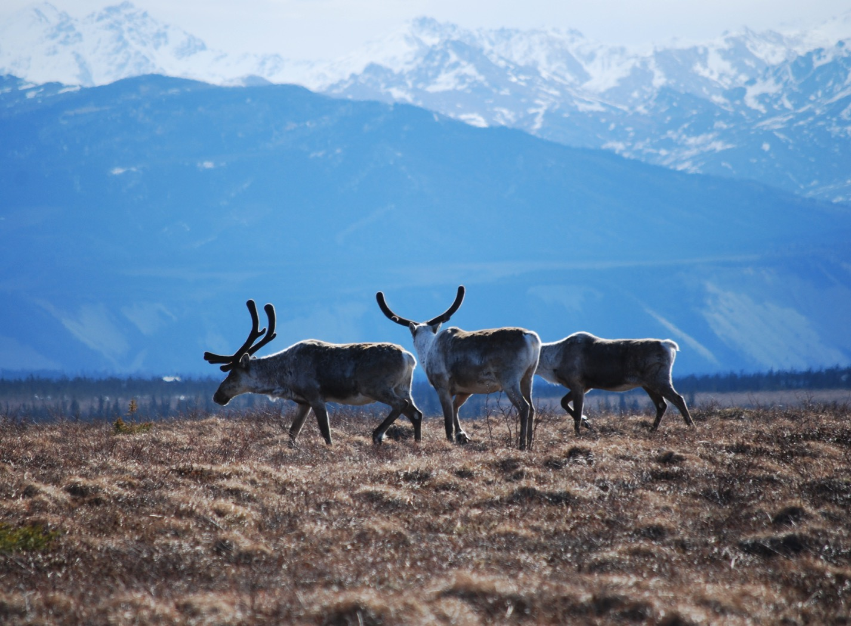
Arctic Boreal Vulnerability Experiment (ABoVE)
2017 ABoVE Airborne Campaign
30 April 2017 (DOY 121)
Atmospheric C: Fairbanks – Bethel – Nome
Charles Miller, Deputy Science Lead
Jet Propulsion Laboratory, California Institute of Technology
and the ABoVE Science Team For Hank Margolis, Eric Kasichke, Bruce Tagg
NASA HQ
April 2017

Slide 2
30 Apr 2017/DOY 121 Fairbanks – Bethel – Nome
Assets Deployed:
Fairbanks – Mooney (N617DH)/Atmospheric CO2, CH4, CO; C Sweeney, S Conley, J Pifer
Daily Summary:
Science Flight
All sensors operating nominally

Slide 3
29 Apr 2017/DOY 120 72-Hour Look Ahead
All plans weather dependent
Sunday 30 April 2017 (DOY 121):
Fairbanks – Galena - Nome
Vertical profiles over Galena, Nome
Monday 1 May 2017 (DOY 122):
Nome – North Slope - Fairbanks
Tuesday 2 May 2017 (DOY 123):
Down Day
Wednesday 3 May 2017 (DOY 124):
Fairbanks – Whitehorse YT
Thursday 4 May 2017 (DOY 125):
Whitehorse YT – Yellowknife NT

Slide 4
30 Apr 2017/DOY 121 Fairbanks – Bethel – Nome
Flight Plan:
Leg 1: Fairbanks – Galena – Bethel

Slide 5
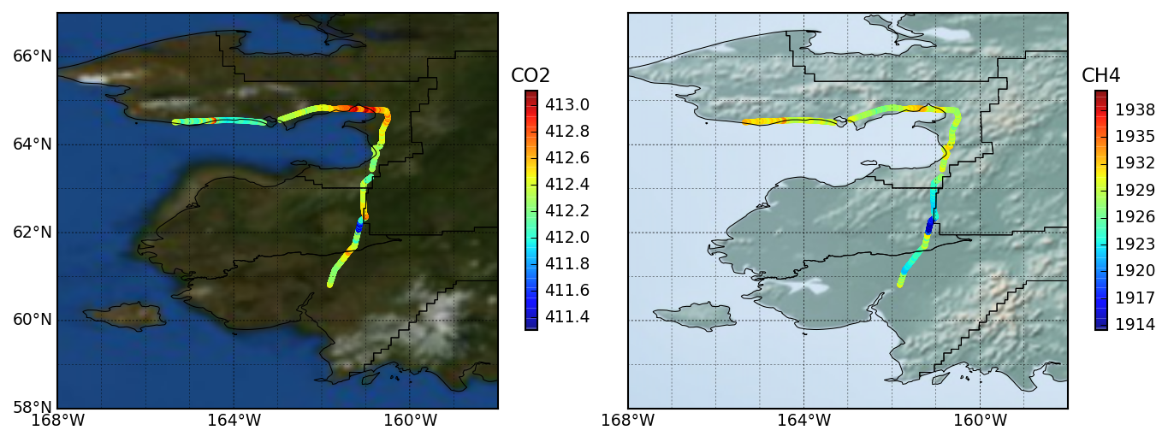
30 Apr 2017/DOY 121 Fairbanks – Bethel – Nome
Flight Plan:
Leg 2: Bethel – Unalakleet – Nome

Slide 6
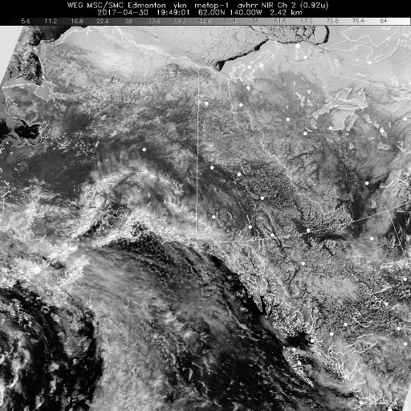
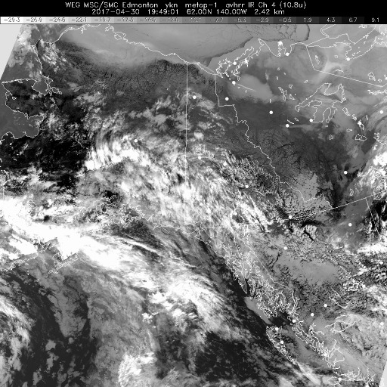
30 Apr 2017/DOY 121 Fairbanks – Bethel – Nome
HRPT NIR
HRPT IR
HRPT Polar NIR (left) and IR (right) show mostly clear conditions across Interior Alaska and on the Seward Peninsula

Slide 7
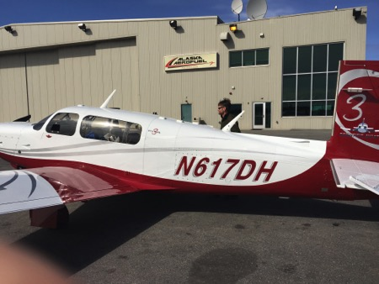
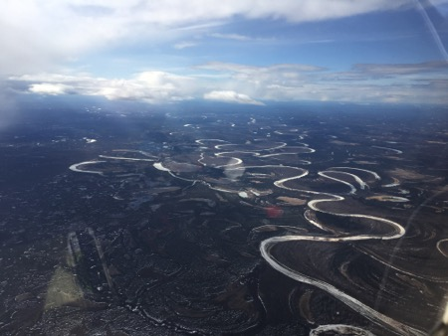
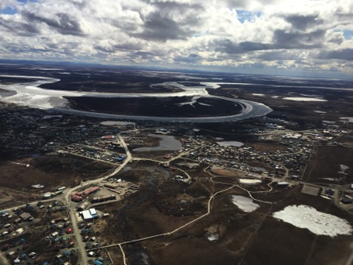
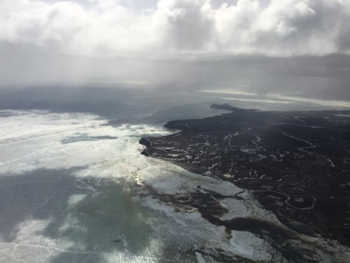
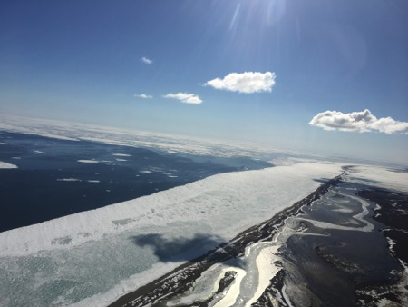
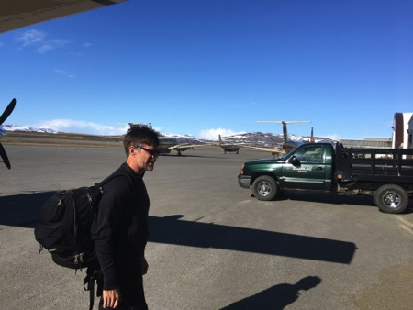
30 Apr 2017/DOY 121 Fairbanks – Bethel – Nome
Stevens Village
Beaver
Interior Alaska shows signs of Spring thaw and remnant snow/ice

Slide 8
30 Apr 2017/DOY 121 Fairbanks – Bethel – Nome
Leg 1: Fairbanks – Galena - Bethel
CO2, CH4 and CO vertical profiles vs altitude and latitude
Moderate near surface (Z < 1 km) CO2 and CH4 enhancements in Interior AK (64-65N)
Little or no near surface (Z < 1 km) CO2 and CH4 enhancement near Bethel (60.5 N)

Slide 9
30 Apr 2017/DOY 121 Fairbanks – Bethel – Nome
Leg 2: Bethel – Unalakleet - Nome
CO2, CH4 and CO vertical profiles vs altitude and latitude
Minimal CO2 or CH4 vertical or north-south gradients in Western Alaska

Slide 10
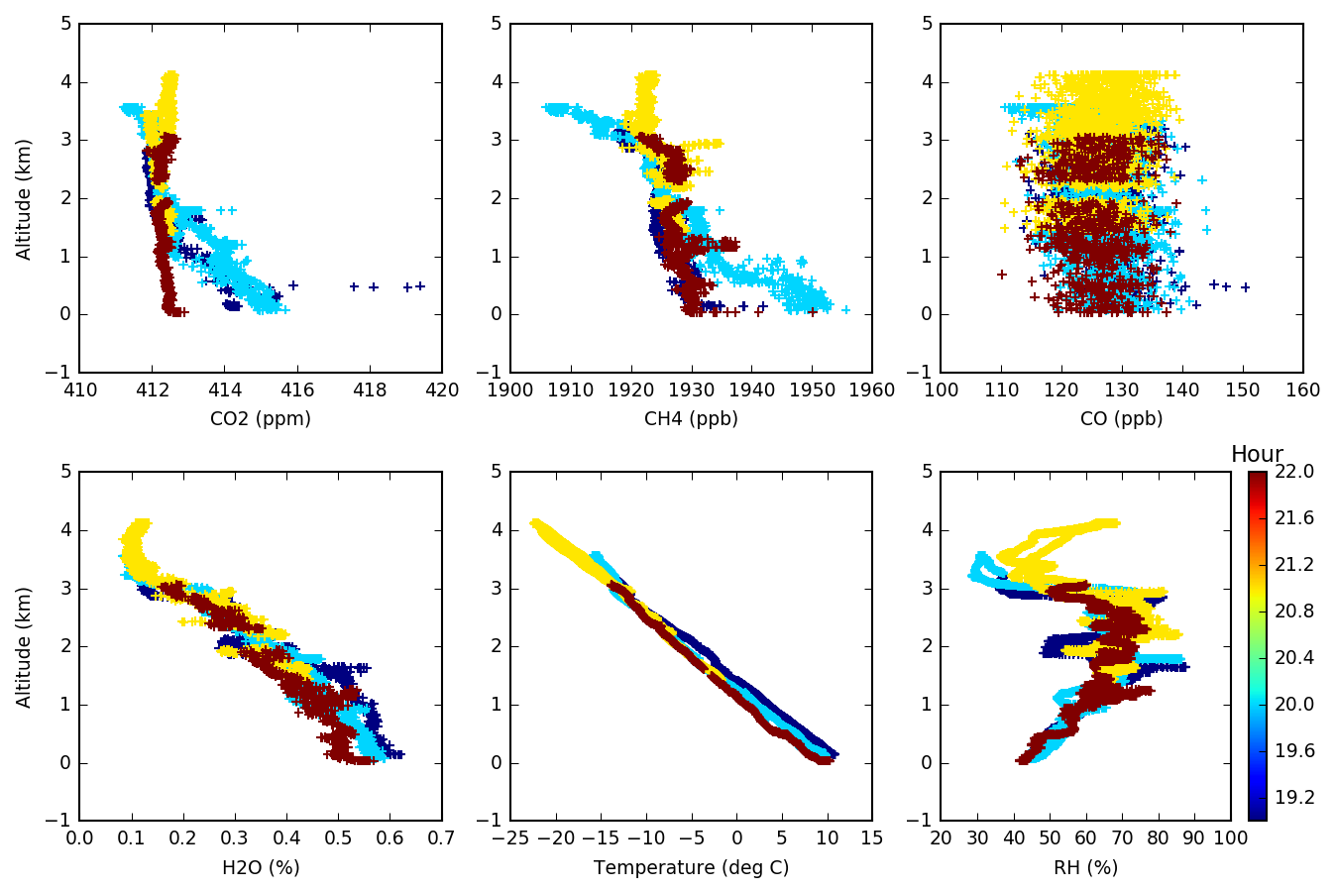
30 Apr 2017/DOY 121 Fairbanks – Bethel – Nome
Leg 1: Fairbanks – Galena - Bethel
Notes:
Profiles show +2-5 ppm CO2 and +20-50 ppb CH4 near surface enhancements

Slide 11
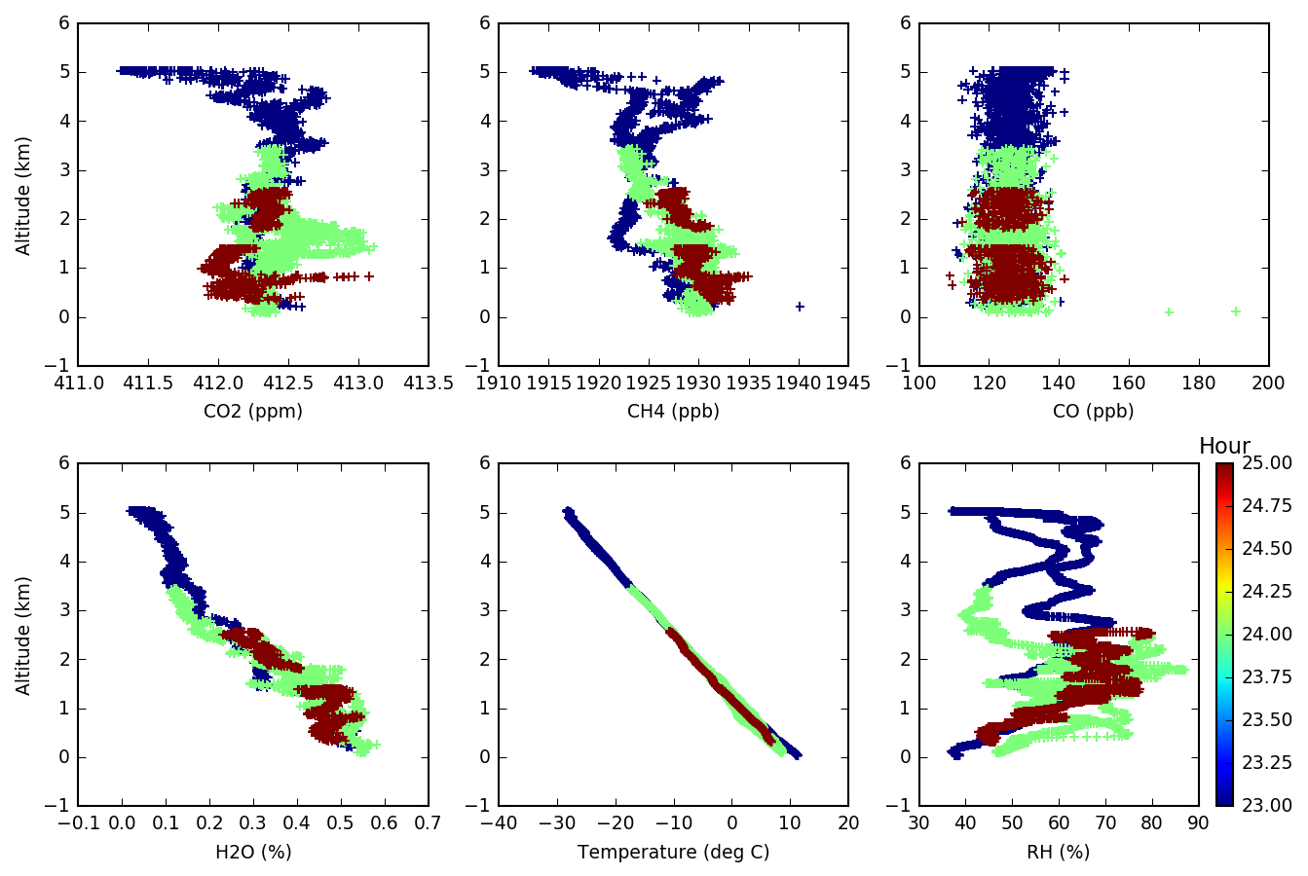
30 Apr 2017/DOY 121 Fairbanks – Bethel – Nome
Leg 2: Bethel – Unalakleet - Nome
Notes:
Profiles show +2-5 ppm CO2 and +20-50 ppb CH4 near surface enhancements

Slide 12
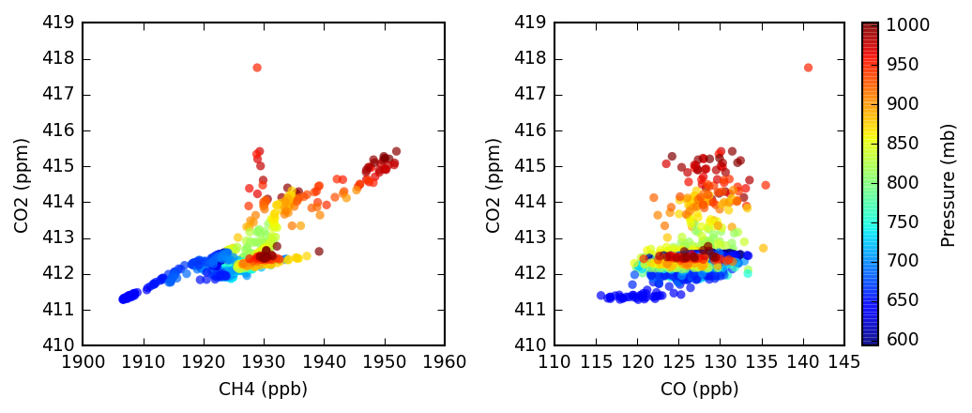
30 Apr 2017/DOY 121 Fairbanks – Bethel – Nome
Leg 1: Fairbanks – Galena - Bethel
CO2 v CH4 and CO2 v CO tracer-tracer correlation plots
Near surface CO2 v CH4 enhancements show evidence of spring thaw
Most CO 130 ± 5 ppb, slightly lower CO above 700 mb
Notes:
+1-3 ppm CO2 and +10-30 ppb CH4

Slide 13
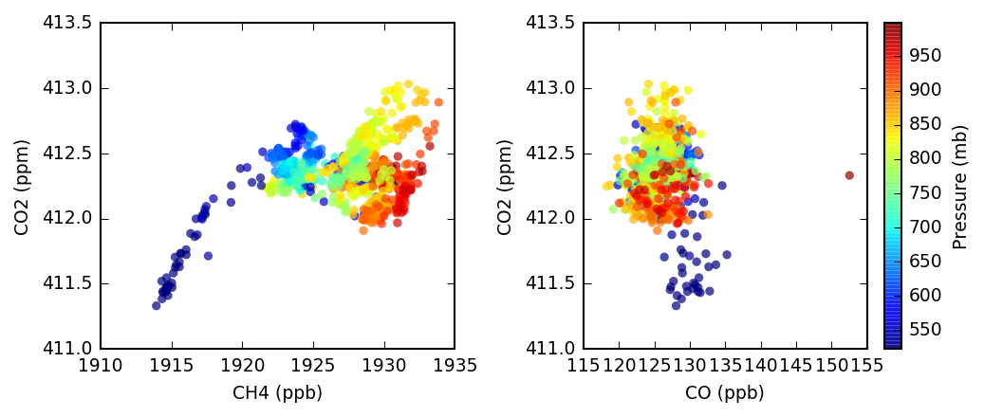
30 Apr 2017/DOY 121 Fairbanks – Bethel – Nome
Leg 2: Bethel – Unalakleet - Nome
CO2 v CH4 and CO2 v CO tracer-tracer correlation plots
Minimal near surface CO2 enhancement, but CH4 exhibits small +5-15 ppb enhancement
CO decreases towards the surface

